Slide 1

JD Driver
Capstone Project 2019
IOS Team

Slide 2
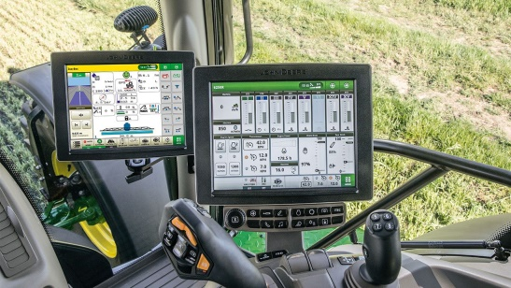


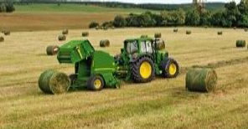

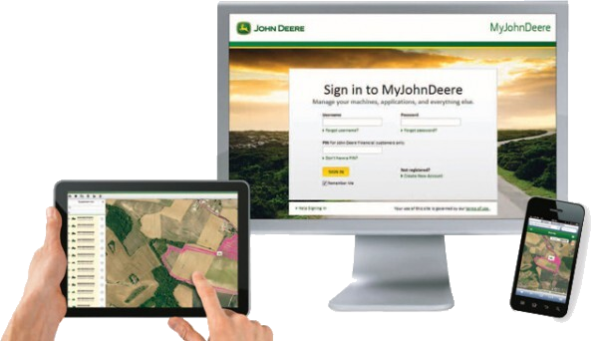
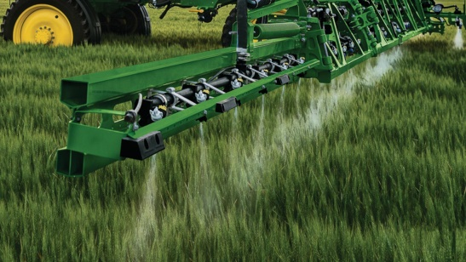
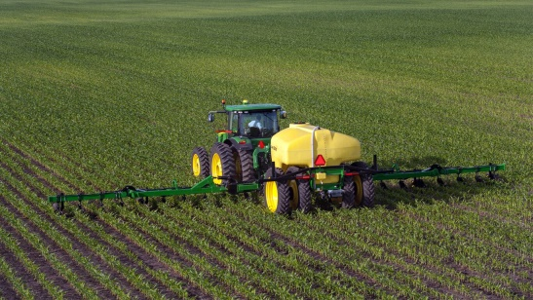
John Deere
But there is something missing…

Slide 3


Project Goal
Not anymore!

Slide 4
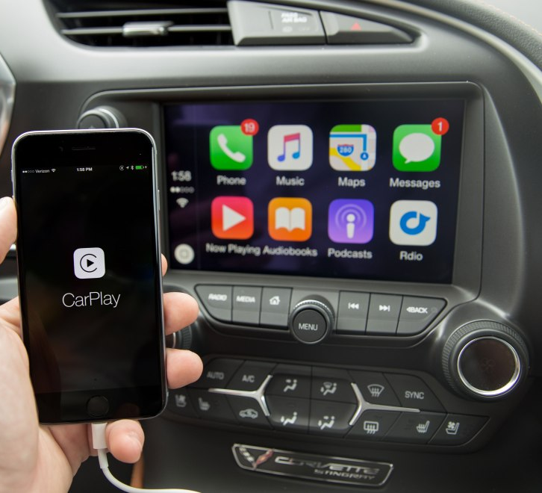
CarPlay
Extension of Operator Interface to Apple Car Play

Slide 5
JD Driver

Slide 6

Who Is Our User
Name: Bob
Occupation: Farm manager
Works at the office
Often visits the fields
Efficient
Likes having full control

Slide 7

The story

Slide 8

In The Office…

Slide 9
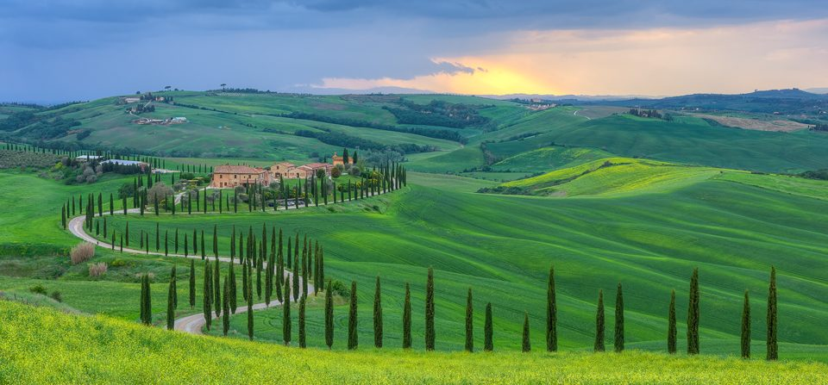







To The Fields…

Slide 10

To The Fields…With JD Driver

Slide 11
(1) Get Nearby Fields

Slide 12
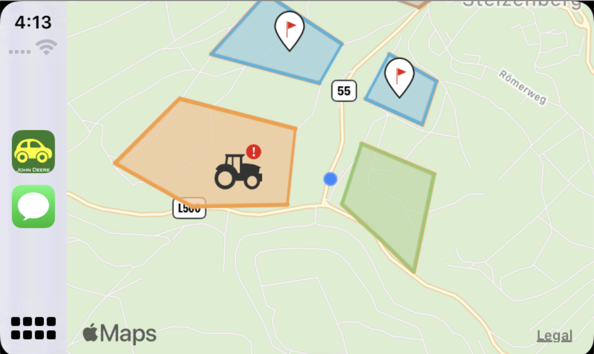
Bob is here ;)

Slide 13
(2) Get Machine Alerts

Slide 14
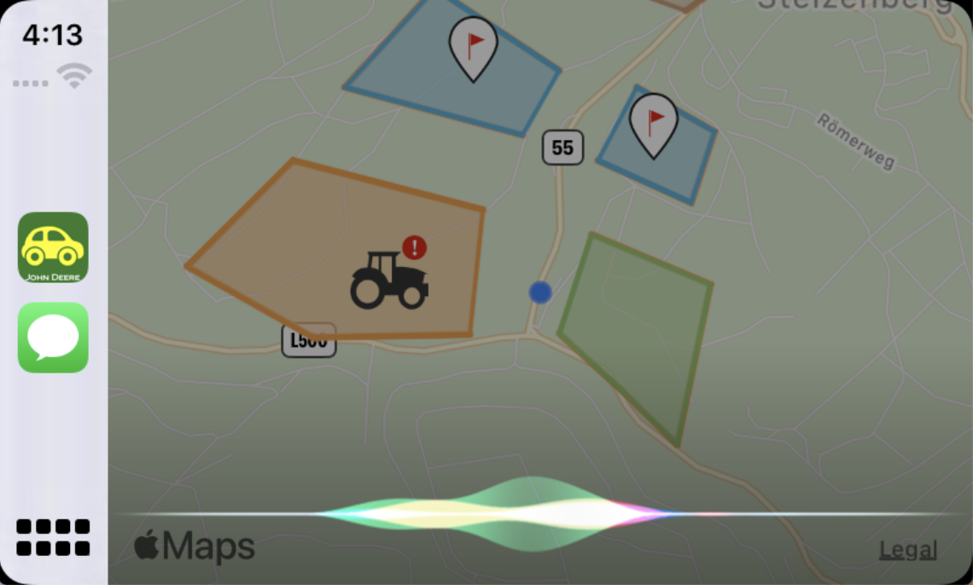
Let’s Try It Out !

Slide 15
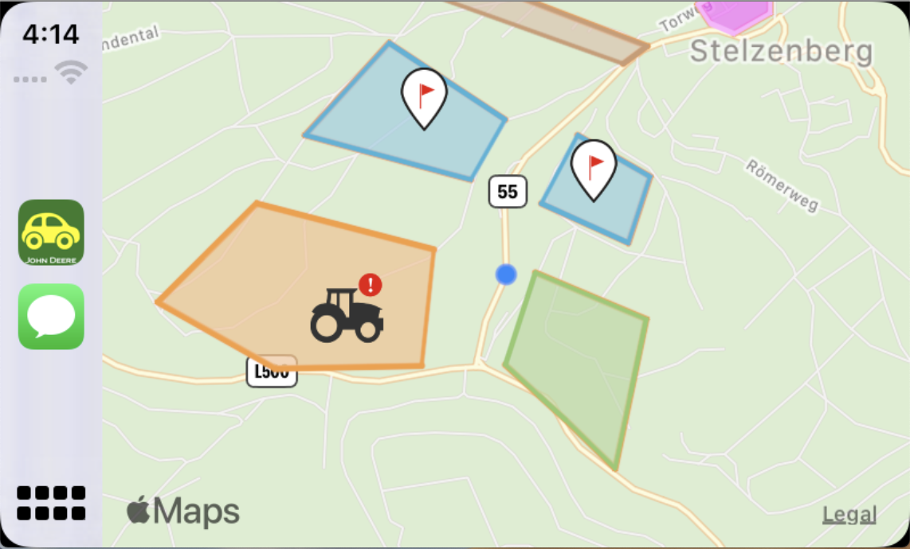

Slide 16
(3) Get Field Flags

Slide 17
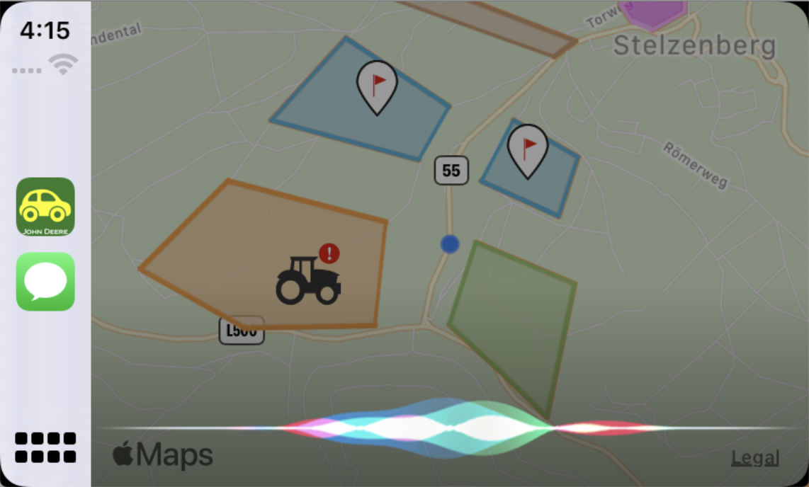
Let’s Try It Out !

Slide 18
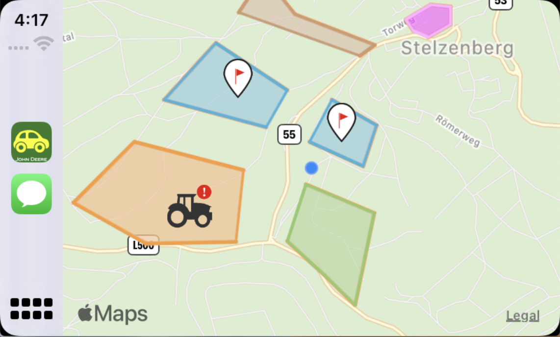

Slide 19
(4) Get Field Updates

Slide 20
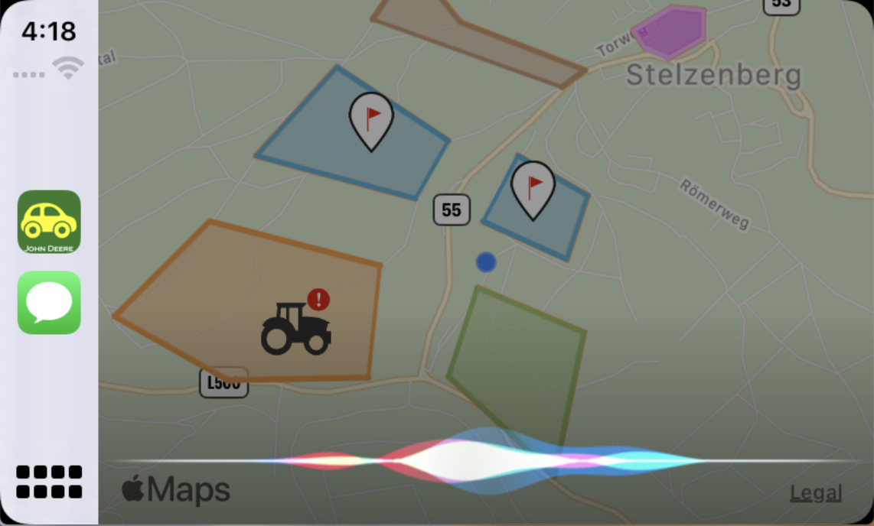
Let’s Try It Out !

Slide 21
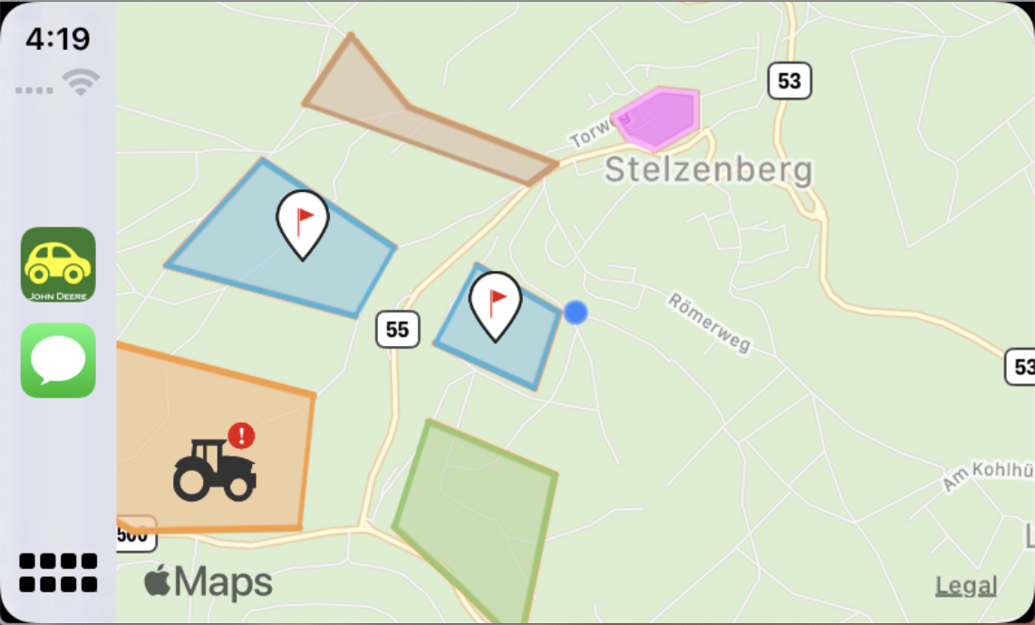
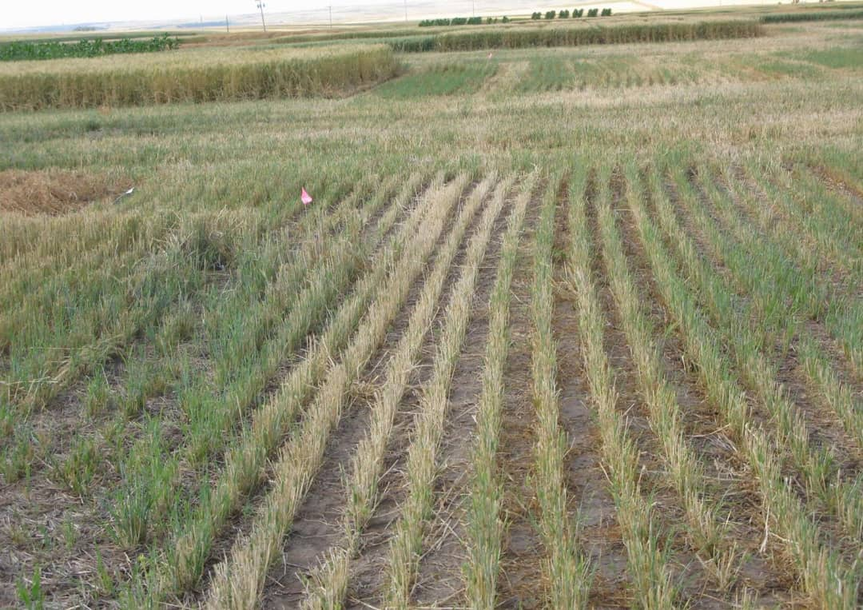

Slide 22




Slide 23
(5) Take a Field Related Note

Slide 24
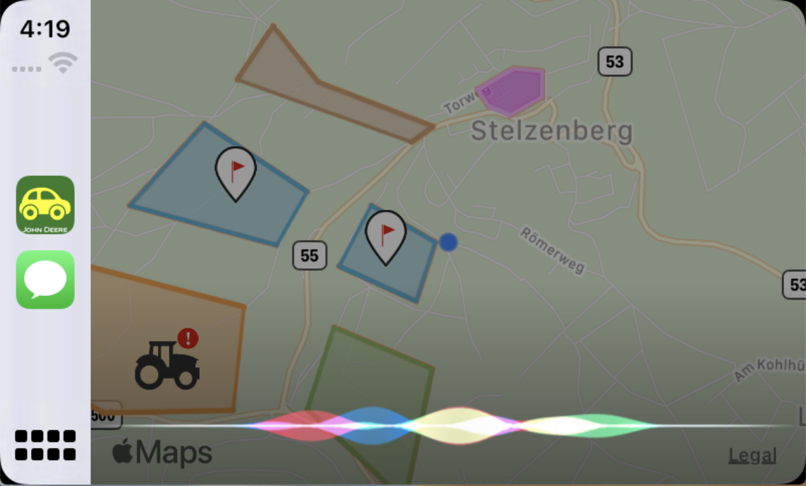
Let’s Try It Out !

Slide 25


(6) Take a General Note

Slide 26
Let’s Try It Out !

Slide 27

Two days Later

Slide 28
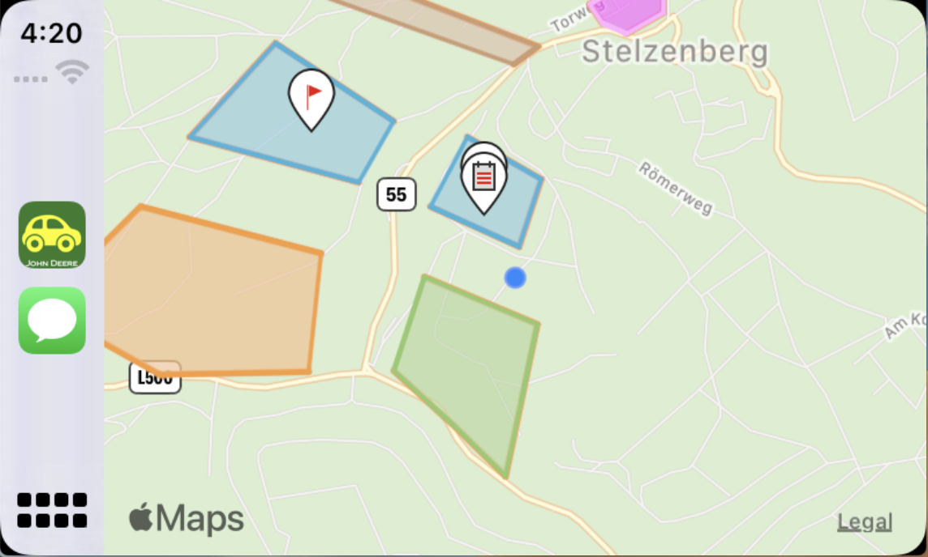

Slide 29
(7) Getting Field Notes

Slide 30
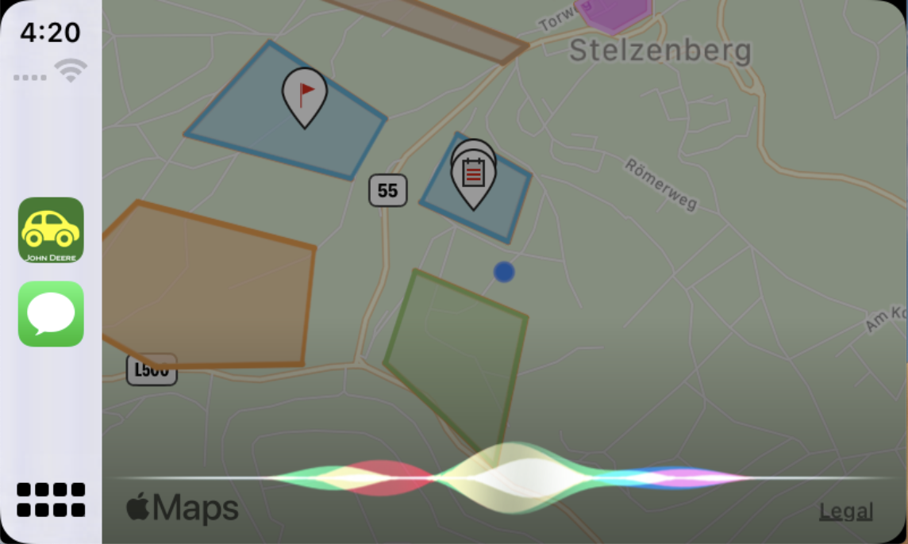
Let’s Try It Out !

Slide 31
(8) Getting General Notes

Slide 32

JD Driver – Features Overview
Get Nearby Fields
Take a Field Related Note
Get Machine Alerts
Take a General Note
Get Field Flags
Getting Field Notes
Get Field Updates
Getting General Notes

Slide 33
Proposals
Customize The Application (Roles)
Reflect The Operation Status (Map Filters)
Improve Updates (Estimated End Date)
Known Info
(Change Icon Color)

Slide 34
Thank you!
Drive Safe
,
While Connected

